Slide 1
Research @UNITA
Universitas Montium
Research structuration and opportunities within the UNITA Alliance
Notes:
1
1
1
1

Slide 2
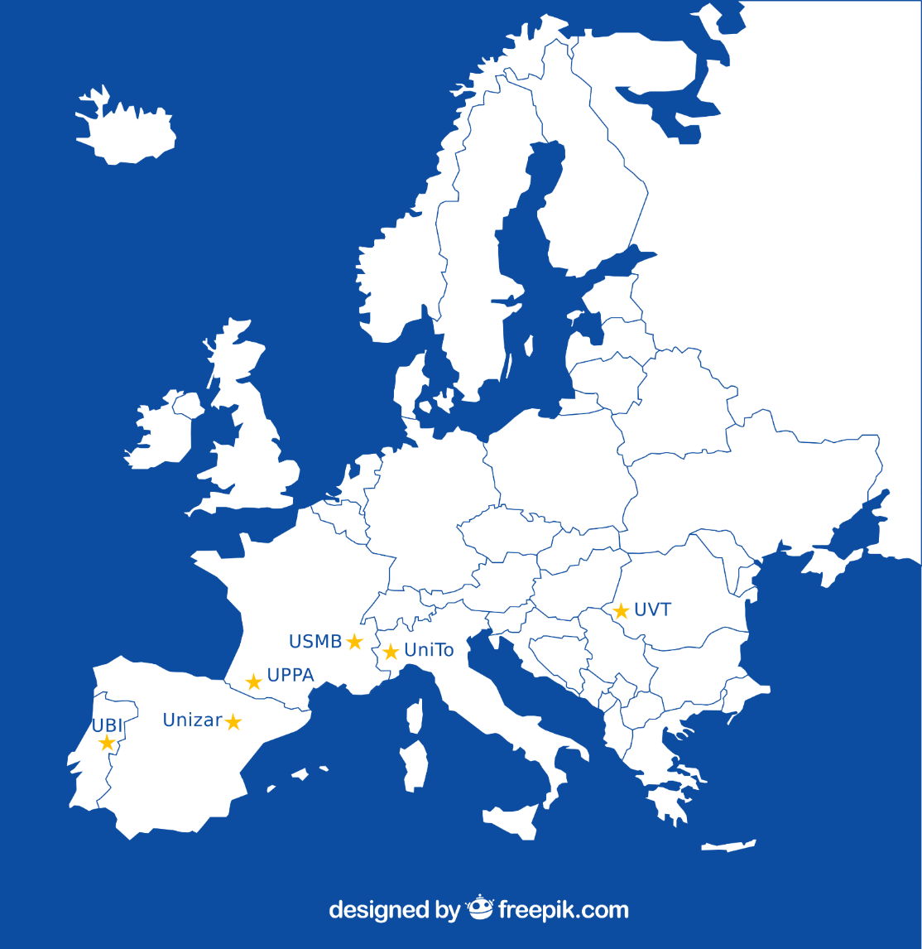
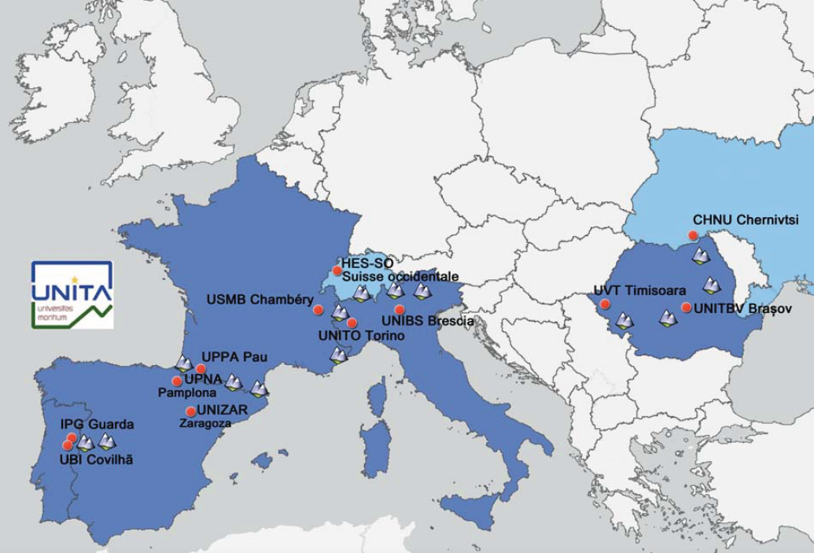
UNITA: building an alliance of European universities
2020
2022
2024
2027
2029
Exploration, Experimentation
Integration, Transformation
Consolidation 2
Consolidation 1
Alliance Expansion
UNITA Phase 1
6 partenaires
Nov 2020-Oct 2023
mainly focused on education
UNITA Phase 2
10 +2 partners + 1 legal entity
Nov 2023-Oct 2027
Research & Education

Slide 3
UNITA research strategy principles:
Connection with territories
Research rooted in local and regional contexts,particularly in rural, mountainous, and cross-border areas, addressing real territorial needs and challenges through strong engagement with local and regional communities.
Open Science
UNITA promotes transparency, accessibility, and sharing of knowledge throughout the research process. Open access to publications, open data, and responsible research practices are key tools to enhance scientific quality and reproducibility.
Bringing science closer to citizens
Citizens are actively involved in research activities, from data collection to co-creation and dissemination of results. Citizen science is considered both a methodological approach and an educational tool to strengthen scientific literacy, democratic participation, and mutual learning between researchers and society.
Innovation
Transformation of research results into innovative and sustainable solutions, policies, services, and technologies, with measurable social, economic and public health impact.

Slide 4



UNITA research hubs
6 scientific focus area at the heart of current societal issues have been defined by the rectors to develop UNITA's research signature
Cultural Heritage (CH): development and dissemination of tangible and Intangible Cultural Heritage, natural heritage
Green energies (GE): GE resources, conversion, management in mountain territories ; Socio-economic and environmental impacts of energy policies
Circular Economy and Environment (CEE): environmental sustainability and circular economy : from material to economic

Slide 5



UNITA research hubs
Global Health (GH): hollistic approach on health issues including diseases, nutrition and food security, environmental health, health inequity, mental health
Inclusive Societies (IS): mechanisms promoting the development of inclusive societies; Social inclusion and equal opportunities
Digital Transition (DT): digital transformation of industry and society, covering cutting-edge, safe and green digital technologies

Slide 6
UNITA hubs organization
Hub are steered by a task force composed of
one representative from each of the UNITA partner & ass. partners
1 leader and 1 co-leader. The leaders and co-leaders are appointed by the vice-rectors for research (with alternating roles).
Each university in the alliance is leader or co-leader of a hub.
UPPA
UNITO
USMB
UBI
UNIZAR
UVT
Hubs created in 2020 extended in 2024
*
Cultural Heritage
Green Energy
Circular Enconomy & Environment
UPNA
UNIZAR
UNITBV
HES-SO
UNIBS
IPG
Hubs created in 2024
Global Health
Digital Transition
Inclusive society

Slide 7
UNITA Research and innovation strategies

Slide 8
UNITA research strategy
Identify UNITA’s research focus area
& develop UNITA Research communities
Advanced Grants
Boost your project to new heights
Access advanced funding to apply for international calls
A five-stage strategy…
Sharing infrastructure
Access partner research platforms and develop collaborations
Starting Grants
Kick off your research with a least 3 UNITA universities
Access initial funding and resources to start you work
Matching Event
Join the ME and finds new partners among UNITA universities
Explore potential collaborations and synergies
Research cartography
…to develop research communities
Let people know that you want to develop collaborations

Slide 9
Key results achieved over the past two years on research
Peer review paper more than 400 PR paper co-signed by 2 partners of the alliance connected with the hub activities
Matching events 12 research matching event organized since 2024, 2 per hub, 1 in each University of the alliance
479 researchers from all the partner universities participated in the events
Starting Grants calls 12 research Starting Grants calls organized since 2024, 2 SG calls per hub related to the matching events.
  151 projects submetted, 79 projects funded (52%)
Bips More than 34 summer/winter school organized the 6 hubs and adressed to master or / and PHD students
Sharing infrastructures 180 specific equipment, 166 plateformes shared at the alliance level

Slide 10
UNITA innovation strategy
provide mutual knowledge and facilitate cooperation in
different domains of the innovation activity
BIP « One Step Beyond »
Starting Grants
Advanced Grants
A four-stage strategy…
Boost tech transfer to new heights
Tap into advanced funding opportunities and support from UNITA
fund early-stage proof-of-concept initiatives, developed collaboratively by teams from at least two UNITA partner universities.
Entrepreneurship education (practical applications of research findings) - dynamics of entrepreneurship and innovation.
Innovation cartography
…to develop innovation
Cartography of the smart specialization strategies and ecosystems

Slide 11
Key results achieved over the past two years on innovation
Smart specialization strategies and ecosystems Cartography
mapping smart specialization strategies for all UNITA regions
alignment of universities with these strategies
Starting tech transfer Grants 2 calls
23 projects submitted, 10 projects funded
Bips on entrepreneurship 2 bips
  BIP1 : 19 people from 10 different Universities delivered the 15 modules of the course. 85 participants + 45 people completing the online part of the course
  BIP2 : Specialized training for staff of Entrepreneurship and Innovation environments.

Slide 12
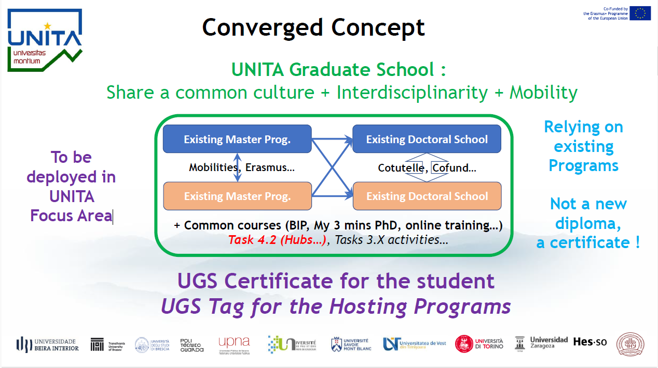
UNITA research & education strategy
Develop synergies between education and research: UNITA graduates schools

Slide 13
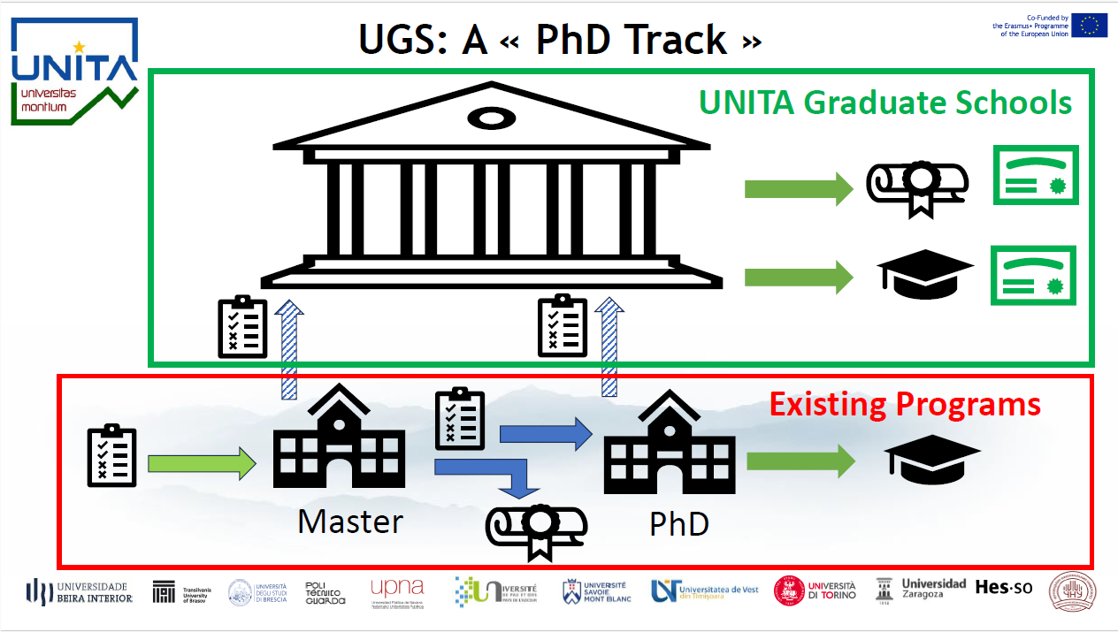

Slide 14
Long term UNITA research strategy
Develop Unita research institutes
Develop six European research institutes linked to their territories (rural, mountainous, cross-border)
  Enable teams to benefit from shared academic, administrative, and infrastructure resources, paving the way for ambitious cooperation projects and expanded funding opportunities.
  Supported by targeted support mechanisms creating a framework conducive to collaborative research, student and researcher mobility, and the strengthening of international cooperation networks.
Strong scientific identity
  Recognized for its specific characteristics at the European level
  Critical mass
  Specific resources
Attractive to young researchers
  Doctoral students
  Teachers-researchers/researchers
Institutional framework to be defined
  Budgetary autonomy
  Administrative structure
  Legal entity?
Linked to territories
  Companies, local authorities, etc.

Slide 15
UNITA research & innovation hubs

Slide 16
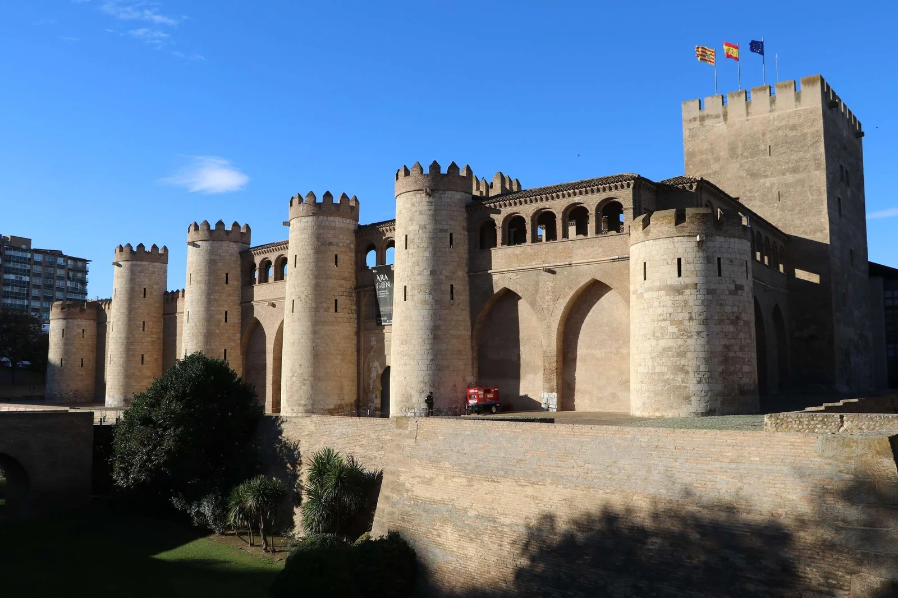
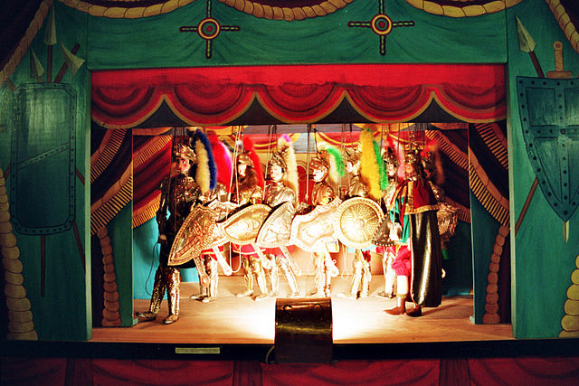

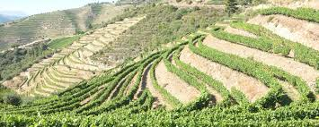
Cultural Heritage (CH) Hub
Hub’s sub-themes
Study and preservation of tangible CH:
visual arts, monuments and buildings, archaeological sites, palaeontology, industrial archaeology, places of memory, museums and collections, art conservation and restoration, legislation for the protection of cultural and natural heritage
Intangible CH and identity narratives:
oral traditions, romance languages and literature, performing arts (music, dance, drama), rituals, travels, cultural identity, religion, collective and individual memory, migrations, vulnerable communities, gender studies, transnational history, values, human rights
Enhancement and dissemination of cultural and natural heritage:
tourism and valorisation, education, communication, heritage management, digitisation/digital tools, storytelling, institutions and heritage
Innovation policies for the development of marginalised areas:
natural heritage and cultural landscapes, climate impact on mountain/rural areas, flora, agriculture, and landscape, culture and food, fauna, livestock farming and biodiversity
Notes:
16

Slide 17
Matching events
ME1: Tourism and cultural heritage in a digital world - Turin 12-13 December 2023
ME 2: Green Heritage : Rethinking Rural Areas in the 21st Century Pau 17-18 October 2024
Starting grants
SG1:
MULTI-PLAY Common heritage in multilingual play to overcome diversity barriers
Conflicts of Memory, Memories of Conflicts : An Interdisciplinary Approach to Cultural Heritage
Places Where We Remember: Cultural Tourism in the Memorial Places of Religious Traditions in Mountain Areas
MountainScape: Exploring cultural heritage in mountain areas through augmented and virtual reality:
Cultural Heritage Animation: Tales in Motion
Digital Cultural Heritage Twins Connections: Bridging Documentation, Analysis and Education from Satellite to Ground (HerOn)
CON.NE.C.T. W.O.N.D.E.R.S.: CONnecting NEw Cultural Tourism WAys Open to Networking Digital Experience in Representing Sites
Decolonizing Women’s History: Collecting Archives and Oral Histories
Mountain sports tourism: development and challenges of reconversion and diversification
Literature about/in the village: Plurilingualism, Identities, Heritage
Creative Mountains : Cultural Heritage as Creativity to Revitalize Mountain Communities
EARTH – Earth And fire in Rural contexts: Towards a Holistic approach to investigate the traces of ancient human fires
Establishment of an Observatory on Tourism in Mountain Refuges
Sharing historical interpretations of rural heritage through a participatory digital methodology, with reference to conflict and peace times
Water heritage: Traditional irrigation systems and uses of water in the mountains
Rethinking Rural Heritage: UNITA Collaborative Network for Researching Cultural Events and Traditions (CONNECT)
GRACE - Green Rural Areas and Cultural Environment. Creating New Policies for the Integrated Management of Cultural Heritage with Green Spaces
Smart Rural Heritage: Digital Tools for Sustainable Revitalization
SG1:

Slide 18
last summer schools organized
Topic | Place | date
Local food and tourism in marginal areas: roots, routes and digitalisation (FATMA) | UNITBV | 02-06 June 2025
History, culture and traditions of mountain areas | UNITBV | 16 – 20 June 2025
TRANSILVANIA CREATIVE CAMP 2025 – Creative Destinations and Heritage Interpretation Summer School | UNITBV | 22-28 August 2025
Religions in conflict. From the Reformation to the 21st Century | UNIZAR | 27-31 October
Multidisciplinary approaches to Antiquity and its heritage: Writing and Society in Greece and in Rome | UNITO | 24-28 November
Upcoming activities
Topic | Place | date
Valorising Medieval and Renaissance French book heritage through language education | UNITO | 20-25 April

Slide 19
Practical information on the CH Hub
Leader, co-leader, appointed representative per university
Core competence
Humanities to Social Sciences
Number of people participating in the Hub’s activities
CH Task Force mailing list: 47 members
CHORAL co-supervisors: 48
Cartography : 177 projects
UBI | Helena Alves
IPG | Ana Isabel Ventura Lopes
UNIZAR | Concha Lomba
UPNA | Eloísa Ramírez Vaquero
UPPA | Laurence Roussillon-Constanty
USMB | Stéphanie Belligon
HESSO | Julia Billeter
UNITO | Giaime Alonge
UNIBS | Irene Giustina
UVT | Otilia Hedesan
UNITBV | Mihai Ivanovici
CHNU | Yuliana Balaniuk
Main project for 2025-2026

Slide 20



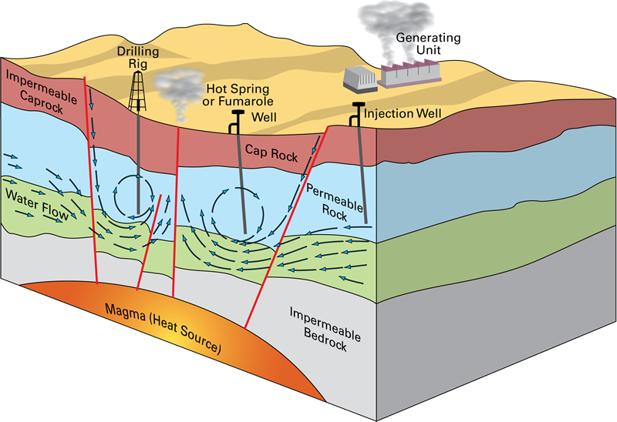








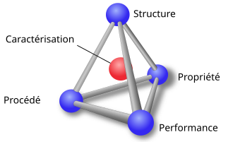




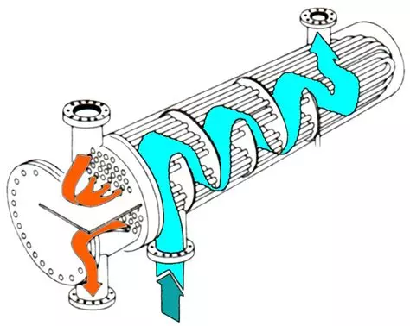


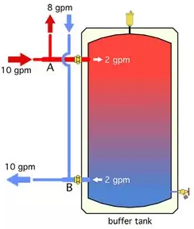


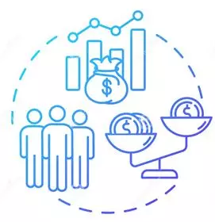


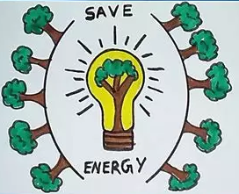
Green Energies (GE) hub
Hub sub-themes
      Renewable Energy resources in the territories (Current local energy resources and prediction of their evolution with climate change)
      Renewable energies conversion (materials and process for Energy collection)
      Energy storage, transformation and distribution (Management of intermittent energy sources and response to local needs)
      Socio-economic and environmental impacts of energy policies (Access to energy and the environmental impact of energy)
Renewable Energy resources in the territories
Windpower
Biomass
Hydropower
Engineering science
Solar energy
Renewable energies conversion
Geothermal energy
Physics, chemistry, materials
Energy storage, transformation and distribution
-
Socio-economic sciences
legal aspects
Socio-economic and environmental impacts of energy policies
Education
Notes:
20

Slide 21
Matching events
ME1: Renewable energy mixes and materials for a more sustainable world Turin December 14-15, 2023
ME 2: Energy mixes in mountain communities favoring local renewable energies Chambery October 17-18, 2024
Starting grants
SG1: Renewable energy mixes and materials for a more sustainable world (30/092024 – 30/09/2025) 6 projects funded
Renewable energy for transport vehicles
Efficient Green Hydrogen Utilization
UNITANE – UNITed towards the development of an innovative technology for solar methANE production
Rural Areas and Mountain Solar Energy Systems based on PhotoVoltaics - RAMSES-PV
RENALPS - Renewable Energies in the Alps
Exploring Plant Fibers: A Dual Solution for Sustainable Thermal Insulation and Food Packaging (FibTherFooP)
SG1: Energy mixes in mountain communities favoring local renewable energies (15/052025 – 15/05/2026) 5 projects funded
BIOHYDROMILL: Bioelectrochemical Valorization of Olive Mill Wastewater for Sustainable Hydrogen and Methanol production and Storage
IDEA-ERA Project: Developing an Integrated Approach to Evaluate Energy Autonomy of Isolated Activities in Rural Areas
Research of the photovoltaic hybrid systems in the mountain area
Redefining sobriety in mountainous areas: from smart buildings to energy-sober communities
Industrial communities in mountainous territories

Slide 22
last summer schools organized
Topic | Place | date
SUNMAT : Critical Raw Material for Solar Development | USMB | November 18–22 2024
Sustainable energy in rural areas | UNIZAR | July 21- 25 2025
Combined Structural and Energy upgrade of buildings in rural areas | UNIBS | September 08-12 2025
Datasun II : Solar Energy in Territories | USMB | November 17-21 2025
Upcoming summer schools
Topic | Place | date
SUN2C : Solar energy for buildings: from components to cities" | USMB | November 2026
Combined Structural and Energy upgrade of buildings in rural areas | USMB | July 2026
Energie renouvelable et entrepreneuriat (in French) | Chamonix | Jully 2026
Upcoming Workshop
Topic | Place | date
Presentation of the results obtained during SG1 | online | March 2026
Call for projects AG - call for expressions of interest setting up of consortia

Slide 23
Practical information on the GE hub
Leader, co-leader, appointed representative per university
Core competence
Physics, Chemistry, materials, engineering, law, economics, social sciences
UBI | António Marques Cardoso
IPG | Rui António Pitarma S. Cunha Ferreira
UNIZAR | Maria Paz Comech
UPNA | Iñigo de la Parra
UPPA | Stephanie Dechezelles
USMB | Benoit Stutz
HESSO | Amelric Ortlieb
UNITO | Sergio Vinciguerra
UNIBS | Lucio Zavanella
UVT | Daniel Vizman
UNITBV | Macedon Moldovan
CHNU | Dmytro Koziarskyi
Number of people participating in hub activities
250 researchers
Cartography 2: 123 projects
Main project for 2025-2026
Matching event & Starting grants
MSCA PHD Cofund (July 2025)
GE Master double diploma

Slide 24
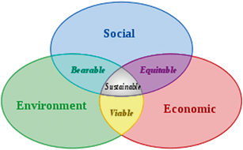
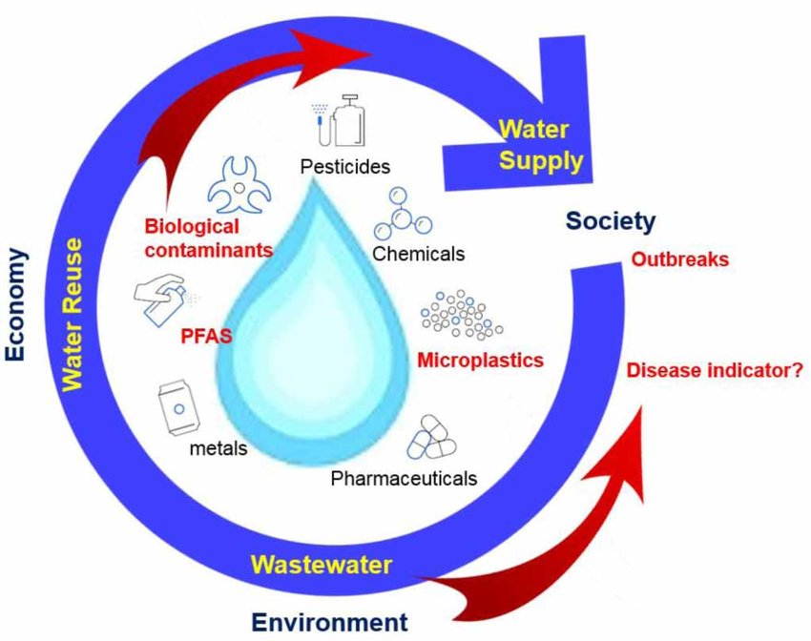
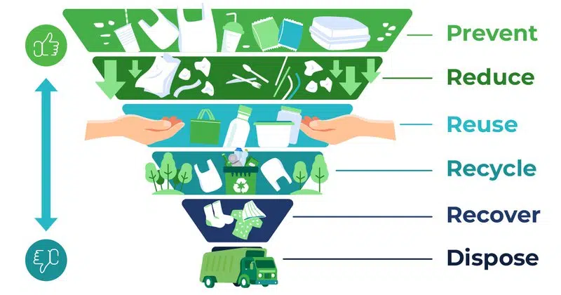
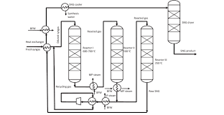
Circular Economy and Environment (CEE) hub
Hub sub-themes
1. Socio-economic dimensions and impacts assessment
2. Sustainability of economic activities in rural and mountain areas
3. Circularity and sustainability in water management
4. Waste materials: prevention, recovery, recycling and reuse
5. Processes and technological solutions for circular economy and environment

Slide 25
Matching events
ME1: Technical and innovative solutions for environmental sustainability and circular economy UNIZAR January 22-23, 2025
ME 2: Social, economic and legal challenges for environmental sustainability and circular economy UVT March 18-19, 2025
Starting grants
Topic 1: Technical and innovative solutions for environmental sustainability and circular economy
VALOR-NET: Valorizing Agro-Food Byproducts through a UNITA Collaborative Network for Circular Economy Solutions
Conversion of Captured Carbon Dioxide from industrial effluents to Methanol with Renewable Hydrogen
Waste-to-Fertiliser solutions for circular and sustainable farming in rural UNITA regions (WAFER)
Composites from Wool Keratin for Circular Applications
New materials and methods for monitoring and advanced treatment of urban wastewater in the frame of circular economy. Make Water Clear
REVIVE – Research and Valorization of Industrial Vegetable By-products for co-sustainable Solutions
Topic 2: Social, economic and legal changes for environmental sustainability and circular economy
Social, economic and legal challenges in water governance for a climate-resilient and sustainable future
CIRCLE-Food: Empowering small businesses from food sector to generate circularity through local policies, branding, and knowledge exchange
Strategic Planning for Open Educational Resources on Risk, Sustainability and Uncertainty
Climate Law Investigation Meaning Approach Transition Environment (CLIMATE)
Circulatio Vini - A circular economy approach for wine production in European rural and mountain regions

Slide 26
Relevant summer schools organized
Topic | Place | date
Environmental issues in the European Union | UVT | June 24th - 28th , 2024
Decentralized water and waste management systems: appropriate technologies and solutions for resilience and sustainability | UNIBS | June 24th - July 2nd, 2024
Green Business in Europe: Managing resilience and sustainability in Europe | USMB | August 26_{th} - 30_{th} , 2024
Biodiversity in Mountain Ecosystems: June 2nd-6th 2025 | UPPA | June 2nd-6th 2025
Upcoming activities
Topic | Place | date
UNITA multidisciplinary PhD programs and co-tutelle best practices, keynote speaker - Marco Zanetti, director PhD Programme in Innovation for the Circular Economy, UNITO | Webinar | 25.02.2026 , 9.30 am CET
SG 1: Technical and innovative solutions for environmental sustainability and circular economy | Webinar | 17.03.2026, 10.00 am CET
SG 2: Social, economic and legal changes for environmental sustainability and circular economy | Webinar | 24.03.2026, 10.00 am CET
Green Chemistry Summer School - BIP | USMB | June-July 2026
Water and Wastewater Reuse Solutions for Small Communities (ReUseWater) - BIP | UBI | June-July 2026
Multidisciplinary seminar "Vineyards, valleys and summits: Viticulture, wine tourism and transition in mountain territories” | USMB | 30th of April 2026

Slide 27
Practical information on the CEE hub
Leader, co-leader, appointed representative per university
Core competence
Chemistry, engineering, law and economics
UBI | António Albuquerque
IPG | Teresa Paiva; André Moreira
UNIZAR | José María Fraile – co-leader
UPNA | Fernando Bimbela Serrano
UPPA | Karine Brugirard Ricaud
USMB | Laurent Duclaux; Dominique Kreziak
HESSO | Julia Billeter
UNITO | Giuseppina Cerrato
UNIBS | Antonella Dosolina Pietta
UVT | Stefana Dima - leader
UNITBV | Alexandru Enesça
CHNU | Victoria Kyfyak
Number of people participating in hub activities
Cartography 1: 194 projects
Cartography 2: 171 projects
30th of April 2025
Main project for 2025-2026
Starting grants & Advanced grants
CE&E Research Talks
BIPs/ summer & winter schools
Webinars/ seminars/conferences

Slide 28
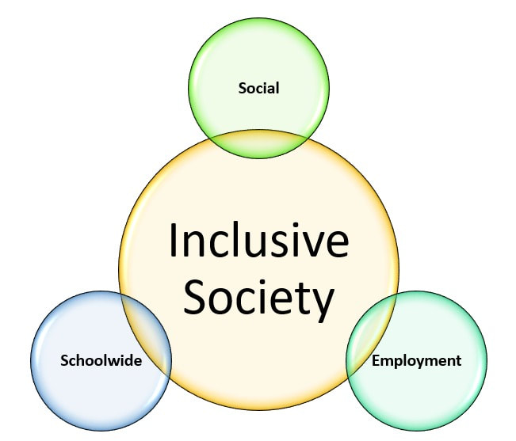

Inclusive Societies (IS) hub
Hub sub-themes
Pathways to inclusive societies: Exploring the role of Democracy, Institutions, Politics, Citizenship, and Information
Social inclusion and equal opportunities in a multicultural setting
Notes:
28
28

Slide 29
Matching events
ME1: Social inclusion and equal opportunities in a multicultural setting Saragoza April 1-2, 2025
ME 2: Pathways to inclusive societies: Exploring the role of Democracy, Institutions, Politics, Citizenship, and Information Brasov May 22-23, 2025
Starting grants
SHE-MAP – Smart Historical Exposure Mapping for Minority Women in Advertising
Political transformations in an era of democratic changes: challenges to social inclusion
COMCRIS Commoning in Crisis: Community, solidarity and resistance in rural and mountainous regions
The Criterion of Consent in the Criminalization of Sexual Offenses: Insights from a European Perspective (CONSENT-EU)
Housing4Youth: Re-imagining Local Communities through Sustainable Housing for Students and Young Workers
W(h)OCAREs? - A Recipe for a Holistic Approach to Women’s Health: Strengthening the Therapeutic Alliance in Gynecological Care
DemoSoc-EU - Democratic Backsliding and Social Inequalities in the European Union: Framing the Interplay in Theory and Action
MORES - Mobility and Remittance Strategies. Circular links among Spain, Italy and Romania, social inclusion and policy implications
DESIGN-IN-LAB – Designing Inclusive Pathways for Migrant Women’s Integration in the Labour Market
Amplifying Silenced Voices Through Service-learning: Towards Polyphonic Solutions
Technologies of Control: critical frameworks, lived experiences, and pathways to justice
Diet and exercise disparities and inequalities in European rural and mountainous areas: Diagnosis and solutions through participation
Inclusiveness beyond “reasonable accommodations”: Toward the concept of “social ergonomics” in the VUCA-D society
Witches: From Marginalization to Reconciliation and Cohesion (ReCo). Crossroads between Social History, Literature, Arts, and Environment
Active Ageing at 25: Lessons, Policies, and Pathways Forward - AA@25
Intersections of Resistance: Young Minority Women’s Digital Voices for Inclusive Societies

Slide 30
last summer schools organized
Topic | Place | date
BIP for STEAM teaching, including digital skills, with gender perspective | UNIZAR | May 20 - 24, 2024
Interdisciplinary perspectives on youth identities and political- social participation (BIPIP) | UVT | July 10 - 15, 2024
Women in the cultural scene | UNIZAR | October 21 - 25, 2024
Democracy and political communication – the role of social media | UBI | June 9 - 13, 2025
Beyond Borders. Migrations, identities, languages | UNITO | July 21-25, 2025
Upcoming activities
Topic | Place | date

Slide 31
Practical information on the IS hub
Leader, co-leader, appointed representative per university
Core competence
Social Sciences, law
UBI | Alcides Monteiro
IPG | Liliana Assunção de Paulo Carona
UNIZAR | Carmen Elboj & Tatiana Iniguez
UPNA | Ruben Lasheras
UPPA | Sandrine Cueille
USMB | Emma Bell
HESSO | Julia Billeter
UNITO | Massimiliano Demata
UNIBS | Susanna Pozzolo
UVT | Elena Baciu
UNITBV | Raileanu Szeles Monica
CHNU | O Ruptash
Number of people participating in hub activities
Cartography 2: 115 projects
Main project for 2024-2025
Develop the community
Matching event
Starting grants

Slide 32




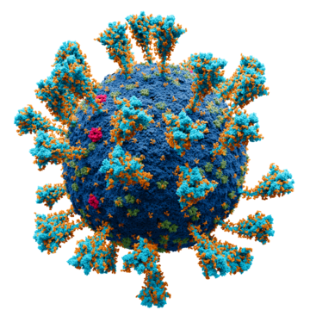
Global Health (GH) hub
Sub-themes
Mental health
Noncommunicable diseases
Cancer
Neurological conditions
Cardiovascular disease
Diabetes
Chronic respiratory disease
Obesity and unhealthy lifestyle
Food security and nutrition
Communicable diseases
Environmental health/One health
Health inequity
Notes:
32

Slide 33
Matching events
ME1: Cellular and Molecular Human and Veterinary Medicine March 18-18, 2025 UBI - HES-SO
ME 2: Mental and Physical Health, Wellbeing, and Prevention Medicine in Humans and Animals
Mai 29-30, 2025, UNIBS
Starting grants
PROJECT NAME
Modulation of Energy Metabolism by treatments and Exercise in Cancer, Obesity, Inmunological blood diseases, and Hemoglobinopathies
Toward a UNITA Student Health Observatory (U-SHO)
Redefining Micro- and Nano-Plastics (MNP) as Active Disruptors of Gut–Liver Barriers and Vectors of Microbial Translocation in Global Health
Targeting insect cytochrome P450 with natural inhibitors: a green strategy for malaria and other vector-borne disease control as a global health challenge
Disrupting Immune-Metabolic Crosstalk in Cancer via Dual Targeting of TLR2 and xCT
EMPOWER
Advancing Knowledge to Promote Health Equity across the UNITA Alliance (AKHE-UNITA).
Spreading global health citizen science research methodologies for UNITA (SPHERE)
REVA: Repurposing drugs to trEat Vaginal yeast: search for new Antimycotics
“MINERVA: Micro/Nanoplastics Exposure and Reproductive Vulnerability Assessment in Ruminants – A Pilot Study with True-to-Life Particles”
ROOTS Rural Opportunities for Ongoing physical activity through Theory-based Strategies
Unfolding Non-Invasive Treatment Advances Against Pain (UNITA-AP) - Validation of novel peptides and their non invasive delivery strategies
Veterinary Cell Therapies in a One Health World (VetCellOH)
MOSAICOH - Mining soil microorganisms for antimicrobial discovery within a One Health approach
NeuroUnita - a transdisciplinary Neuroscience platform of the Unita alliance
HEALPS (Health & Environment in the Alps). OneHealth Mountains – Building a Multidisciplinary Network for Sustainable Mountain Futures
Lifestyle Behaviours, Mental and Physical Health, and Oral Health in Students and Migrants living in Mountain Areas: a Preventive Medicine Perspective

Slide 34
Last BIPs organized
Topic | Place | date
Cell and gene therapies | UBI | July 2025
Managing Vital Emergencies | HES-SO | June 2025
Upcoming activities
Topic | Place | Date
Webinar series, to follow up on SG | web | January
Webinars to improve networking | web | Feb-Dec
Summer School on environmental health | TBD | TBD

Slide 35
Practical information on the GH hub
Leader, co-leader, members of the GH task team
Core competence
Life sciences, chemistry, psychology, sport science, veterinary, economy and law.
UBI | Ana Paula Duarte/Ana Cristovao
IPG | Maria FátimaSantos M. Roque
UNIZAR | Inma Martín Burriel/Alfonso Abecia
UPNA | Iñigo Lasa
UPPA | Julien Bois/Gautier Zunquin
USMB | Sonia Pelissier
HESSO | Amalric Ortlieb
UNITO | Alessandro Vercelli/Luca Bonfanti
UNIBS | Donatella Placidi
UVT | Florin Alin Sava
UNITBV | Tudor Badea
CHNU | Lidiia Khuda
Number of people participating in hub activities
Cartography: 264 projects
86 participants to the matching events
24 starting grants projects presented
Main projects for 2024-2025 :
Structure the hub activity
Matching event & Starting grants

Slide 36






Digital Transition (DT) hub
Hub sub-themes
  AI & ML applied to different fields
  e-learning e-Health
  IoT & Telecom Cybersecurity
  Advanced manufacturing & Industry 4.0
Notes:
36

Slide 37
Matching Events
ME1: Intelligent Information Processing for the Digital Transition: Promises and Risks: Guarda, 25-26 March 2025
ME2: Green and Secure ICT for the digital society in Anthropocene: Pamplona, 29-30 May 2025
Starting Grants (5/9/2025 - 4/9/2026)
SG1: Intelligent Information Processing for the Digital Transition: Promises and Risks: 4 projects funded
  Theory of Mind and Conversational engagement in Human-AI interactive Technology
  Social robots in education: weaving networks & opening paths
  Automating clinical scoring with LLMs: A pragmatic digital transition
  Adaptive Intelligent Tutoring Chatbot for Education and Industry
SG2: Green and Secure ICT for the digital society in Anthropocene : 2 projects funded
  BE-SAFE – BicyclE SAFEty for Mobility and Active Riding in Smart Cities
  Intelligent Management of Mobility and Parking in Mountain Low-Density Heritage Cities

Slide 38
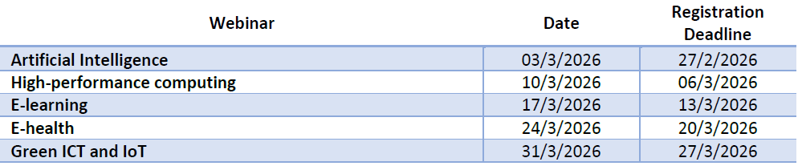
Upcoming webinars
Upcoming workshop
Presentation of the results obtained by Starting Grants & Advanced Grants call (Online). Friday 27 March 2026
Upcoming Summer Schools
International Summer School on AI: From Life Sciences to Governance and Security. Pamplona, 15-19 June 2026
Green Tech and Creative Technologies. UBI, June 2026 (Tentative)

Slide 39
Practical information on the DT hub
Leader, co-leader, appointed representative per university
Core competence
Telecommunications, Computer Science, Engineering, Mathematics, Social Sciences, Law, Economics
UBI | Bruno Correia
IPG | Catarina Carreto
UNIZAR | Alfonso Ortega
UPNA | Antonio Lopez
UPPA | Philippe Roose
USMB | Emmanuel Trouvé
HESSO | Ortlieb Amalric
UNITO | Lavinia Tagliabue
UNIBS | Federico Cerutti
UVT | Sebastian Stefaniga
UNITBV | Mihai Duguleana
CHNU | Yuriy Ushenko
Number of people participating in hub activities
>120 researchers
Cartography 2: 108 projects
Main project for 2025-2026
Starting grants & Advanced Grants
Exploration of external funding sourcesl
Alliances with regional EDIHs

Slide 40


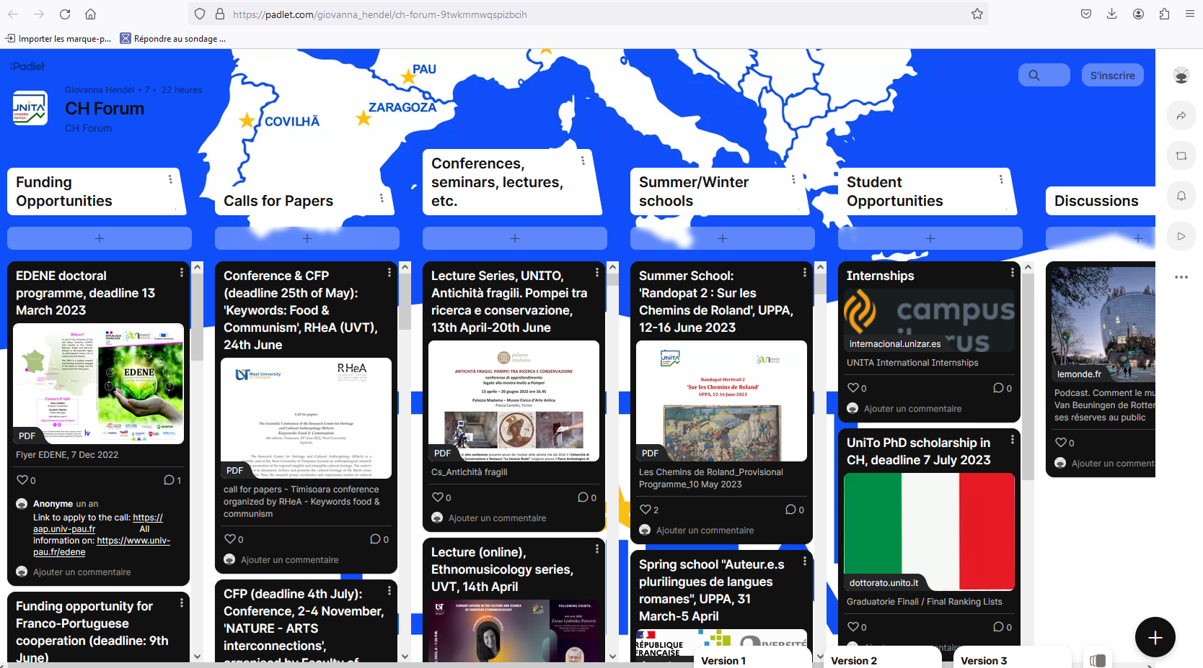
Hubs activities
Are you looking for information on UNITA research hubs and their activities ?
Go to the research pages of the UNITA website!
https://www.research.univ-unita.eu/en/hubs.html

Slide 41
UNITA Research calls

Slide 42
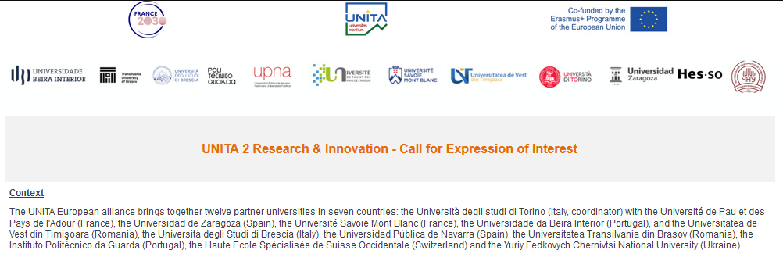
Research cartography
Call for expression of interest open all around the year to let the Unita community know that you are interested in collaborating on research activities, to publicize your skills for future collaborations
Are you looking for partners to develop international research project ?
Let us know by responding to the call for expressions of interest in research
Your projects will help to complete the cartography of UNITA's research activities.

Slide 43
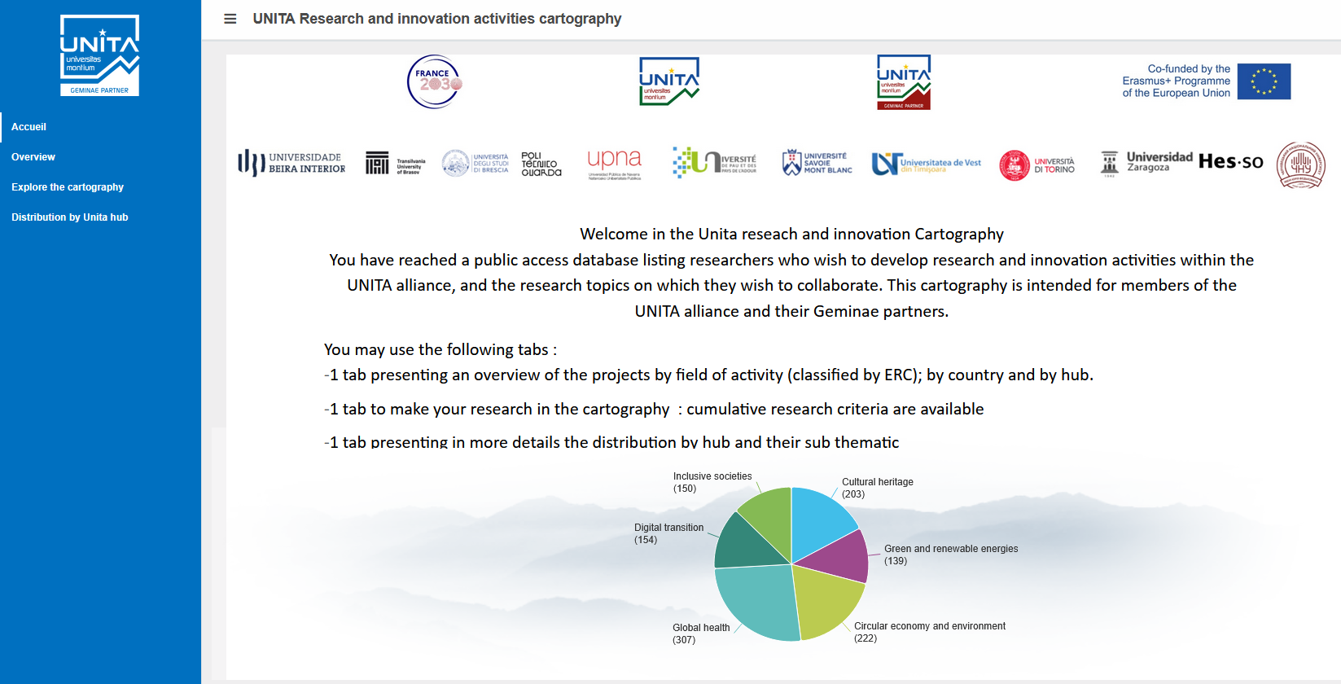
Unita Research Cartography
Accessible on the website
Looking for a partner to set up an international research project?
Use the Unita research cartography, which includes more than 900 proposals for international collaboration.
https://s2.sphinxonline.net/report/recherche/UNITA_AMI/Carto.htm

Slide 44

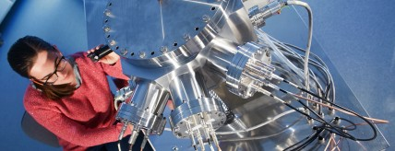
UNITA – CALL for Shared Research Infrastructure Grants
Call open all around the year to access to partner research platforms
(mission expenses and platform usage costs covered by the alliance)
Objective : support the use of shared research infrastructures and resources among its member institutions.
Shared Infrastructure Database https://reunitaresearchinfrastructure.i3a.es/
Eligibility Criteria & Terms
Involve two or more UNITA partners
Align with one or more of the research hubs
Include funding for equipment usage or technical training
Information
Detailed information are available on UNITA research website: https://www.research.univ-unita.eu/en/support-for-researchers/shared-research-infrastructures.html

Slide 45
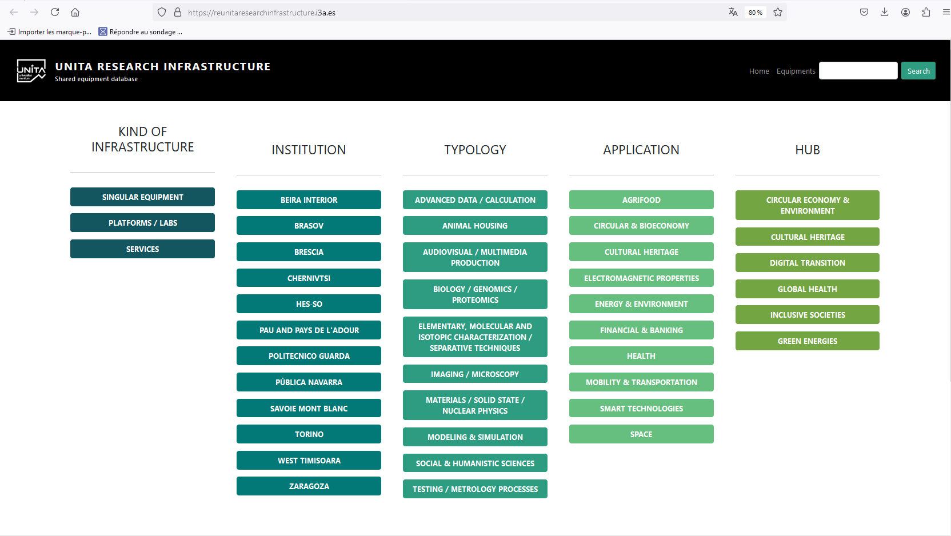
UNITA's Research Infrastructure platform
Accessible on the website
Looking for a specific instrument for your research?
Use the UNITA infrastructure sharing tool to find out if the tool is available from an alliance partner and get in touch with the contact person.
https://reunitaresearchinfrastructure.i3a.es/

Slide 46

UNITA Calls for Advanced Grants on Research
2nd Mars - 17th April 2026
A proposal must result from one or more starting grant project The consortium and project members may evolve. The project may welcome new members to complete the teams.
A project must be submitted by at least three different UNITA Partners of the UNITA Alliance.
Each Principal Investigator, Team Leader and Team Member can only participate in one project.
UNITA Associated Partners and UNITA Geminae Partners are encouraged to participate in this call and join the research project teams, without requesting funding.
Project start date: July 20 - 2026 Project end date: August 31 - 2027
This call finances projects up to a maximum of 10 k€ per partners,
The maximum amount to be attributed per partner is 12 k€.

Slide 47
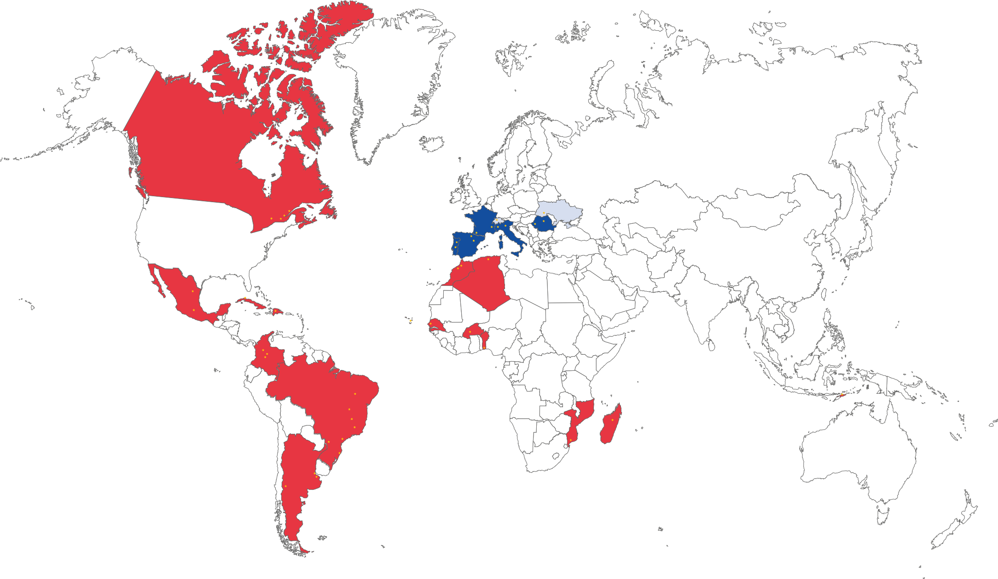
Geminae partners
The network of UNITA partners outside Europe
Looking for a partner outside Europe to develop your international projects?
Visit the Geminae web pages, the UNITA alliance's network of partners

Slide 48
Merci de votre attention!
Obrigado pela sua atenção
Grazie per l'attenzione !
Vă mulțumim pentru atenție
Gracias por su atención

